Slide 1
StayAwake Carrier alert and planning system
Codejam 12
Presented by !Recursion
Arman Shroff-Mehrabadi
Edgar Desnos
Marcus Kam
Nick Triantos

Slide 2
Problem
According to the NSC, roughly 18% of truck drivers report falling asleep behind the wheel, and drowsy driving could be involved in upwards of 40% of truck crashes
We hope to develop a product to ensure the safety of carriers behind the wheel and provide analytics to avoid driving fatigue by smarter route and schedule planning

Slide 3
Dimensions of solution
Real-time alert
Alert driver when needed
Pain point addressed:
Drowsiness while driving is hazardous for carriers and surrounding drivers. Keeping carriers awake and alert could save lives.
Fatigue monitor
Route planning
Computer vision to detect drowsiness
Data analytics to identify high-risk segments

Slide 4
Technology infrastructure
Eye aspect ratio (EAR) calculated per frame indicates drowsiness, triggering alarm when needed
Arrange stops before high-risk segments or adjust schedule accordingly
Hand-held device
Web App Display
Backend and DB
Camera
Real-time face mesh detection and landmark extraction using OpenCV2 and mediapipe
Storage of geographical information (lat. & long.) where carriers frequently fall asleep

Slide 5


Target users and need addressed
Long-haul truck drivers
Logistic planning
Alarm system to keep drivers awake
Better route and schedule planning ensures adequate rest
Minimizing fatigue and sleep-deprivation reduces accidents
Higher satisfaction and productivity

Slide 6
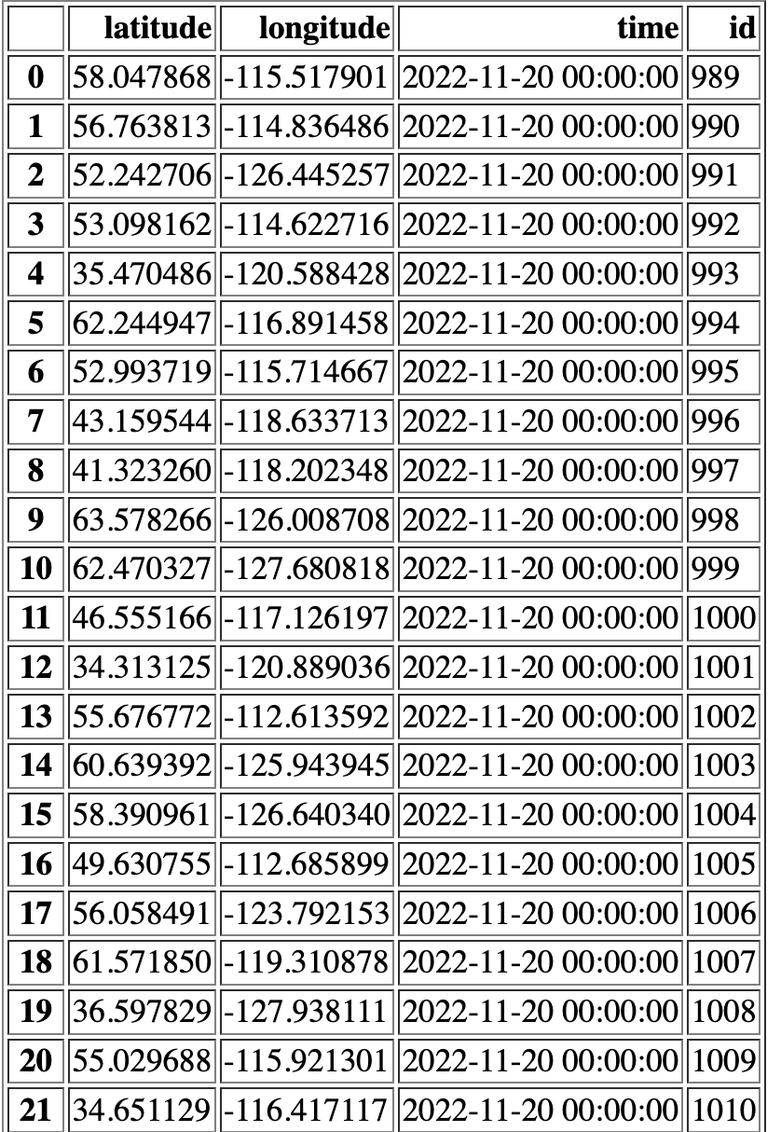
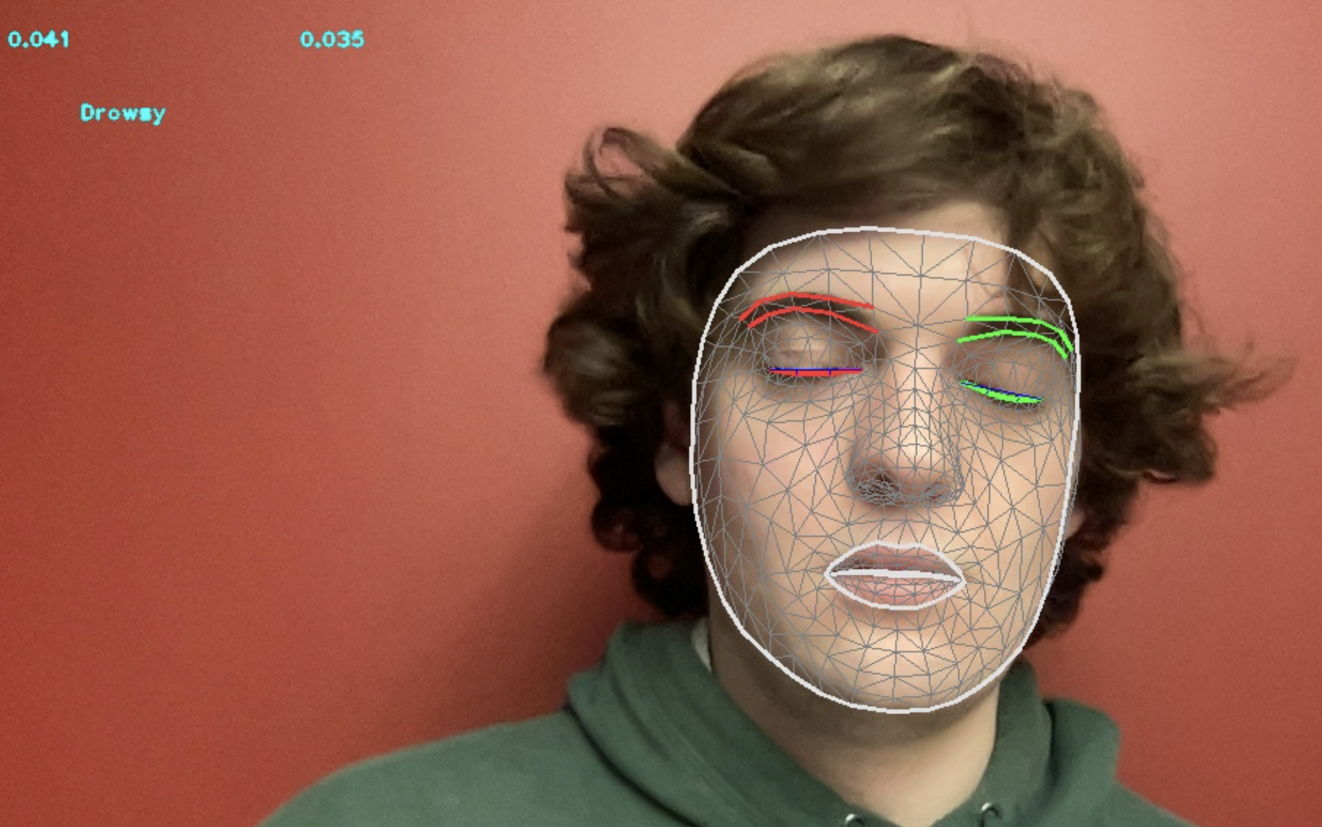
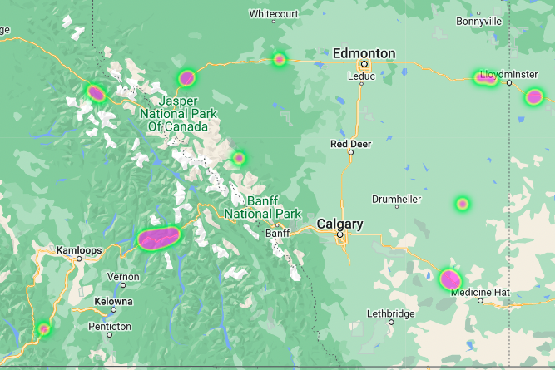
Product Snapshots
Drowsiness detection interface
Data storage
Geographic analytics*
*Under development

Slide 7
Future recommendations
Adaptive navigation
Automatically reroute to the nearest rest area (e.g. ONroute) when drowsiness is frequently detected
Interesting topics
Reddit-style fun fact or customized feed as replacement of alarm

Slide 8


Thank you!

